Slide 1



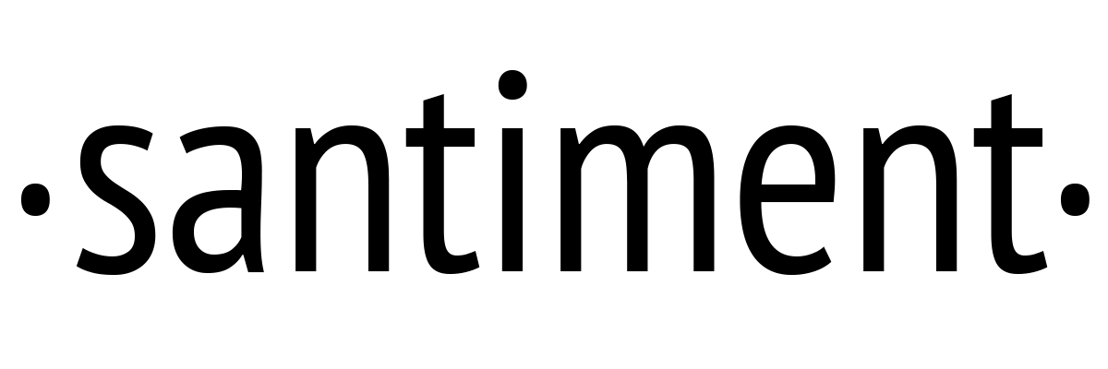
santimentfeed
Maksim Balashevich
Founder, Santiment
Santiment創業者
Welcomeようこそ！
Deep behaviour analyses of the MakerDAO events and data
Behavioral finance focuses on the fact that investors are not always rational, have limits to their self-control, and are influenced by their own biases.

Slide 2
Since its inception,
the Ethereum ecosystem has passed through different states.
We are in a DeFi State now.
What data has been generated so far? Can we use it for the cryptomarket analyses?
Notes:
Since the inception of Ethereum
Different states of the Ethereum Ecosystem
Transitions from one state to another
Is one story to be told

Slide 3
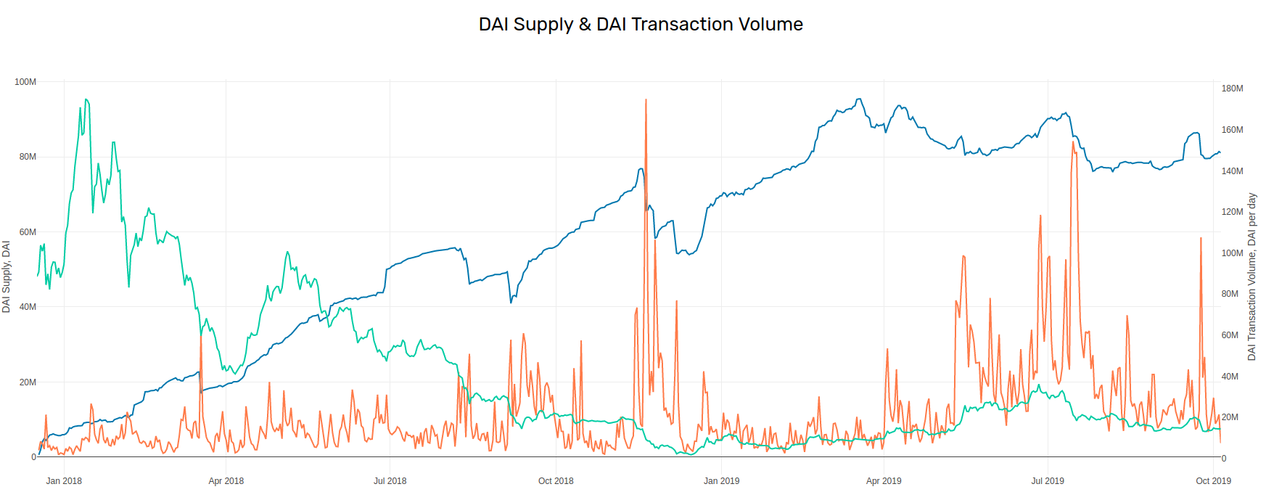
On-chain Data/オンチェーンデータ
Source: graphs.santiment.net/makerdao
取引ボリューム
DAI transaction volume ETH price DAI supply

Slide 4
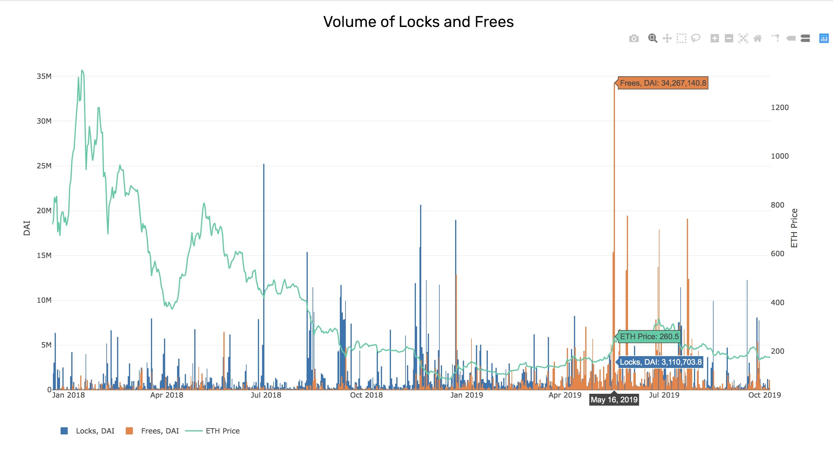
On-chain Data/オンチェーンデータ
Source: graphs.santiment.net/makerdao

Slide 5
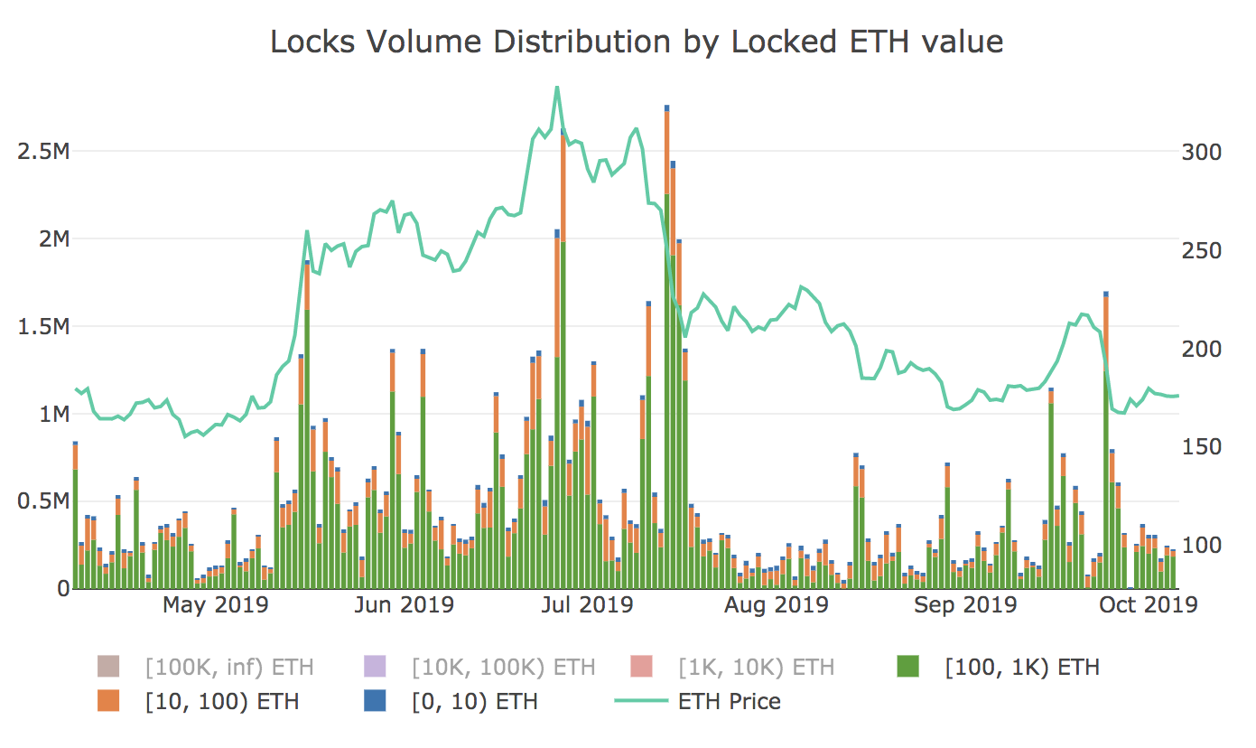
On-chain Data/オンチェーンデータ
Source: graphs.santiment.net/makerdao

Slide 6
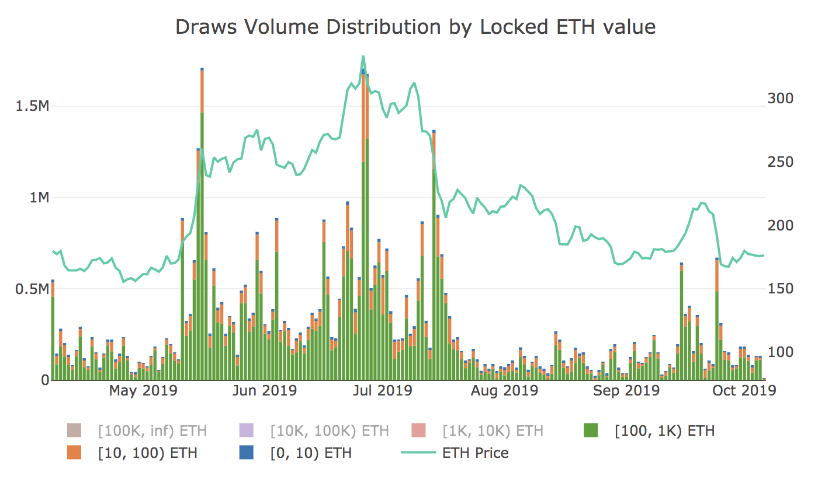
On-chain Data/オンチェーンデータ
Source: graphs.santiment.net/makerdao

Slide 7
On-chain Data/オンチェーンデータ
Source: graphs.santiment.net/makerdao

Slide 8


Key learnings
MakerDAO data is unique
Should be analysed together with the price
Represents the crowd behaviour almost perfectly
What kind of analyses can be done
Spotting the tops
Change of the trend

Slide 9

Stay in contact! ご連絡お待ちしております！
devcon.santiment.net
maksim.b@santiment.net

